Slide 1


Timetable Recommendation program
for SKKU student
Team 4
2020312852 Kim Min
2021313128 Kim Woomin
2019314864 Min Yeeun
2018312186 Park Seongmin
2021313553 Oh Wonjun
2021314455 Choi Yeonjae
2023313243 Zulsyahmi bin Zulkefli

Slide 2


Timetable for skku
Index
01 l Motivation
02 l Goals & Overview
03 l Implementation & Demo
04 l Test plan & result

Slide 3
Timetable for skku
Section 1
Motivation

Slide 4
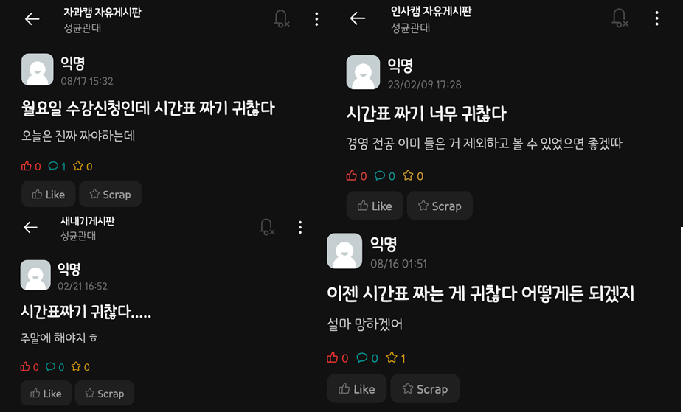
Timetable for skku
Motivation
Many students are stressed when organizing their timetables.

Slide 5
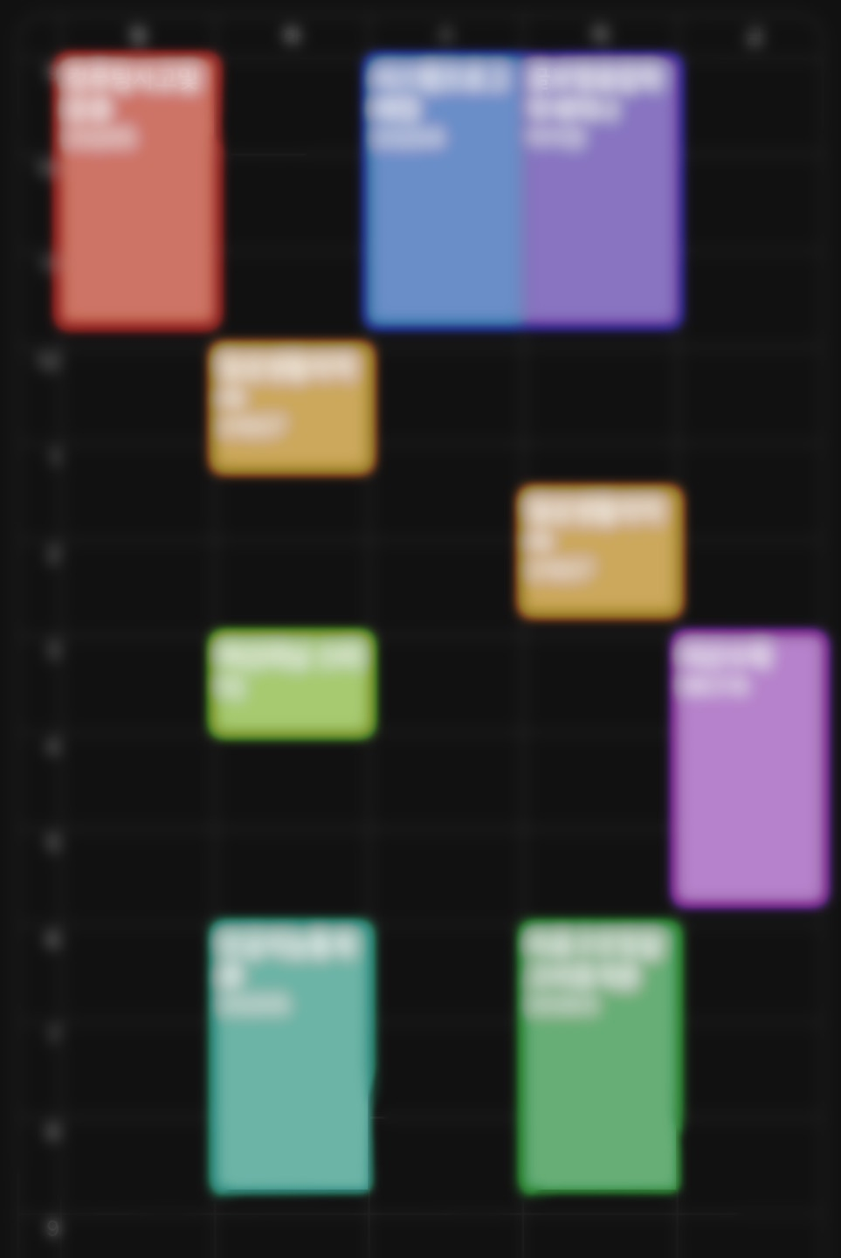
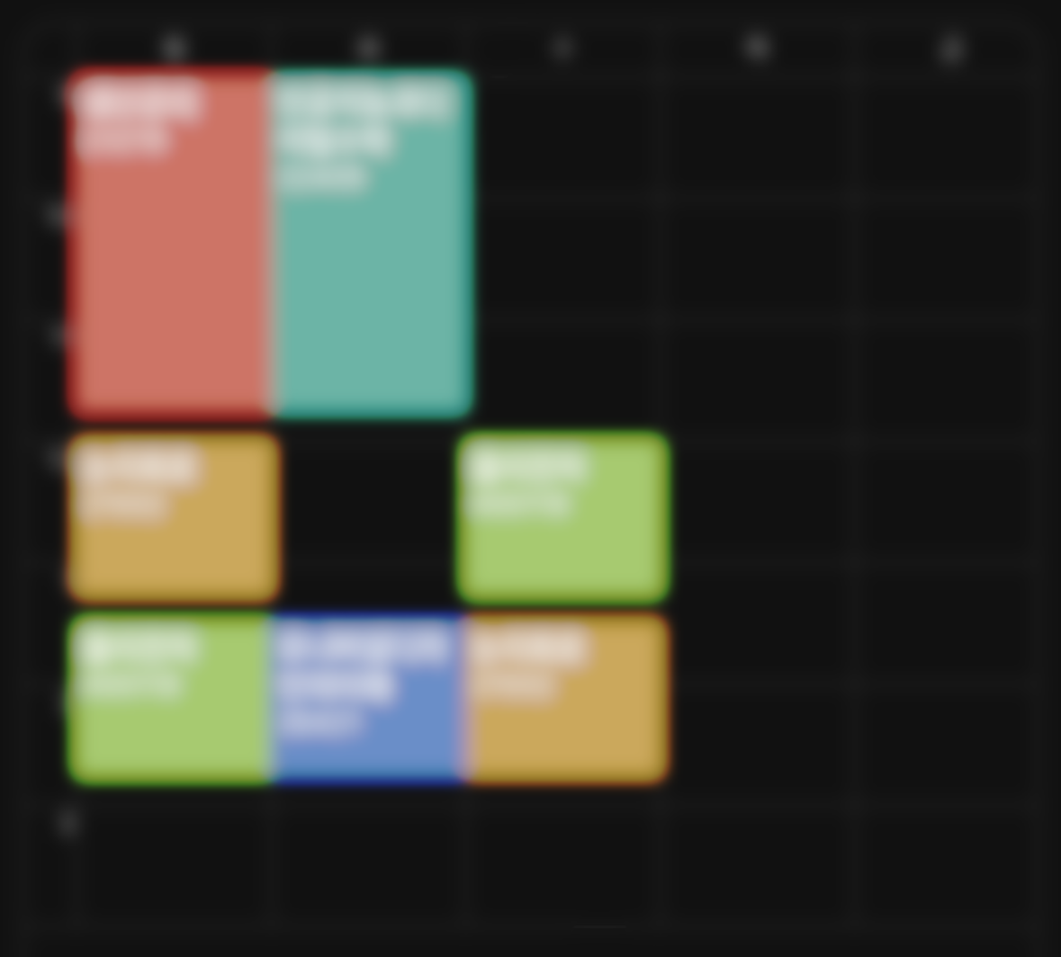
Timetable for skku
Motivation
2. Each student has unique preferences.
Factors such as double majors, taken courses, the ratio of major to elective courses, and preferred timetable structures should be considered.
OR
?

Slide 6

Timetable for skku
Motivation
3. Enhancing Efficiency:
Ensure students avoid unnecessary repetition and better manage their credits.
An organized and efficient timetable enhances academic achievement.

Slide 7
Timetable for skku
Section 2
Goals & Overview

Slide 8





Timetable for skku
Goals
Personalized Scheduling: Create timetables that reflect individual preferences and needs.
Course Management: Exclude taken courses and balance major and elective subjects according to students' preferences.
Stress Reduction and Time Efficiency: Reduce stress and time by automating the scheduling process.
Enhanced Focus and Productivity: Provide optimized schedules and improve focus and academic performance.

Slide 9
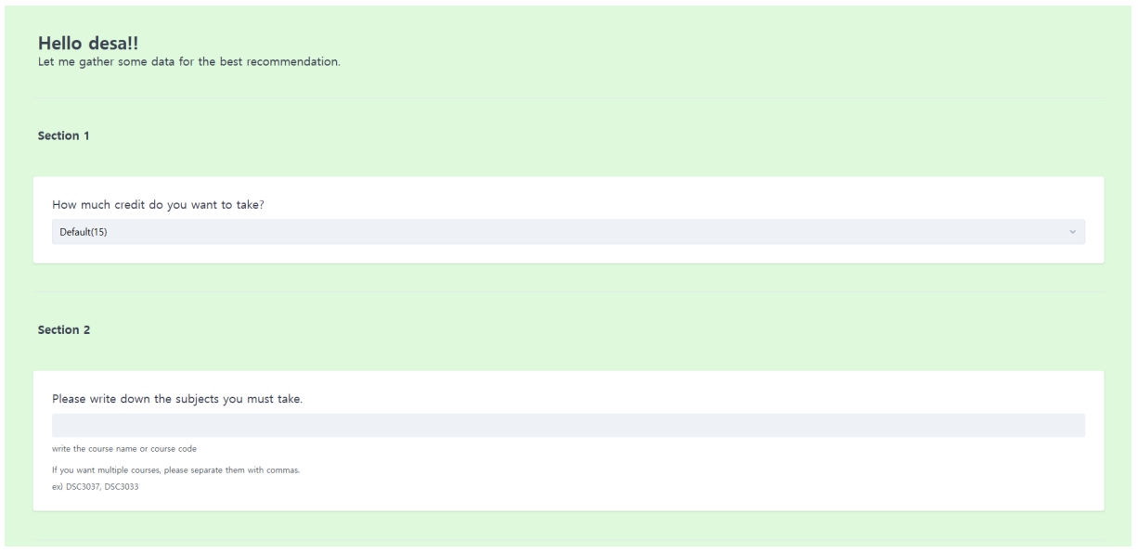
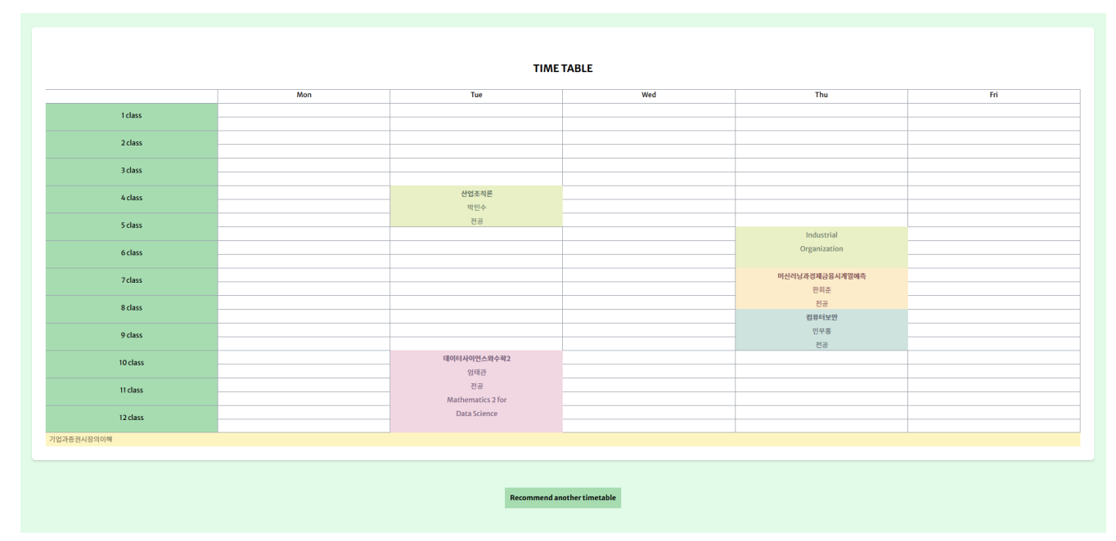
Timetable for skku
Overview
Main Functions
Survey to reflect personal preference
Timetable Recommendations
Reduce stress and complications regarding course management

Slide 10
Timetable for skku
Section 3
Implementation & Demo

Slide 11
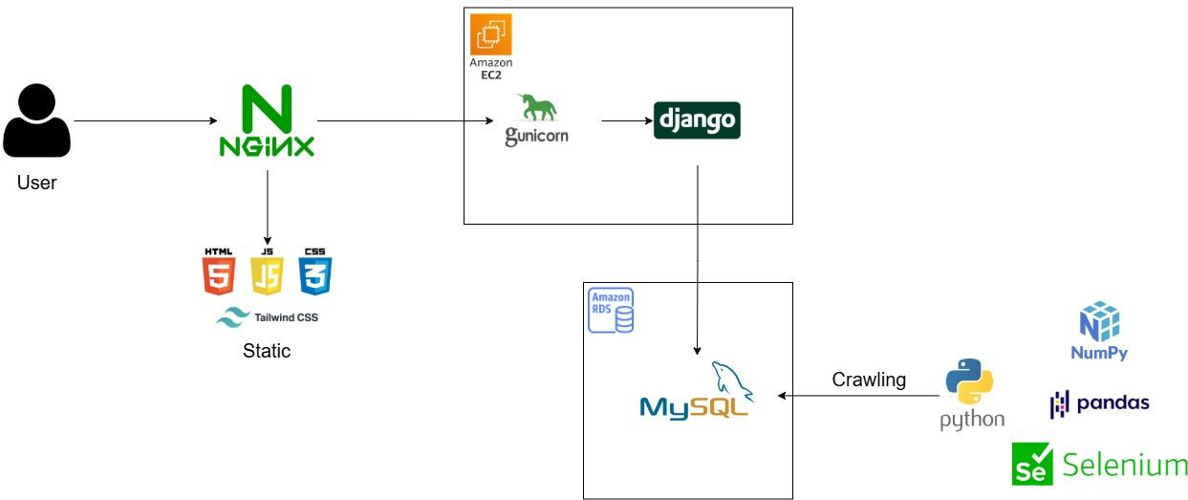
Timetable for skku
Implementation
Architecture

Slide 12
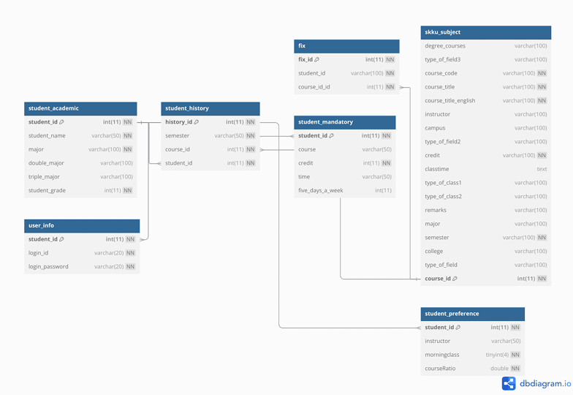
Timetable for skku
Implementation
DB model

Slide 13
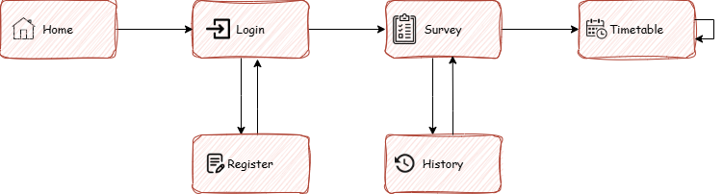
Timetable for skku
Implementation
User flow

Slide 14
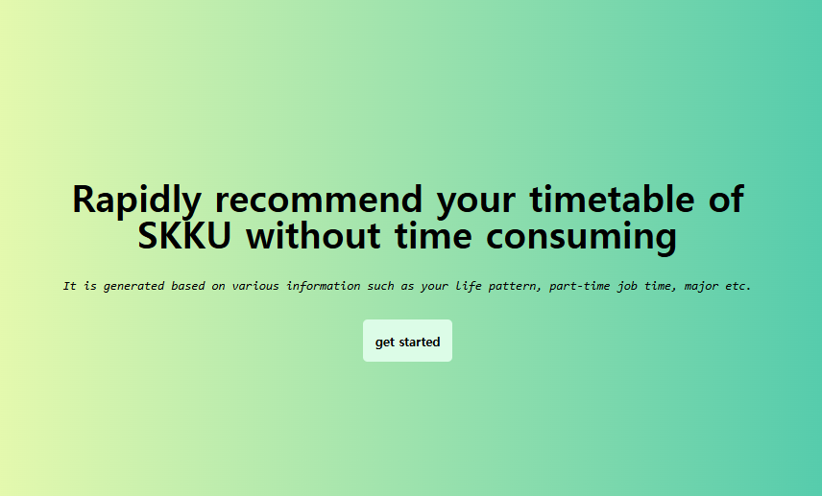
Timetable for skku
Implementation
User flow
Home page
This is the first page you see upon entering.
Click the "get started" button to proceed to the Login page.

Slide 15
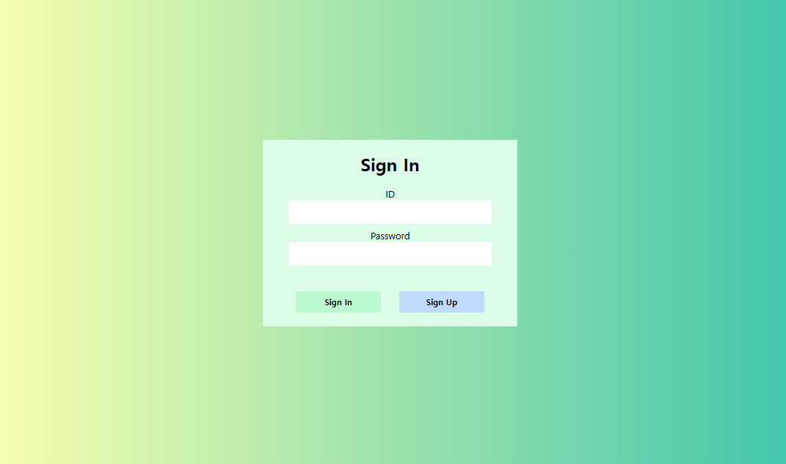
Timetable for skku
Implementation
User flow
Login page
Log in with your registered account.
After a successful login, you will be redirected to the Survey page.

Slide 16
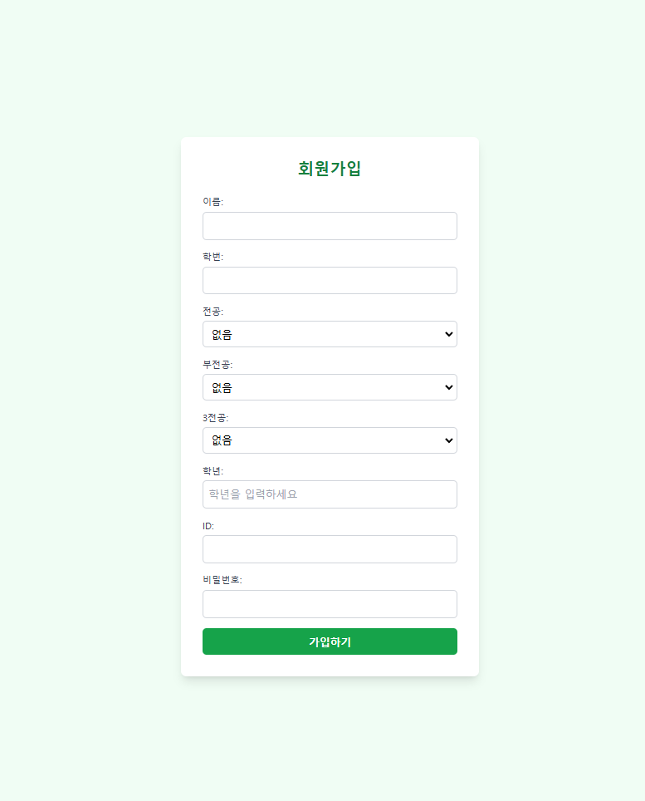
Timetable for skku
Implementation
User flow
Register page
Create a new account to get started.
Once your account is created, you will be redirected to the home page.

Slide 17
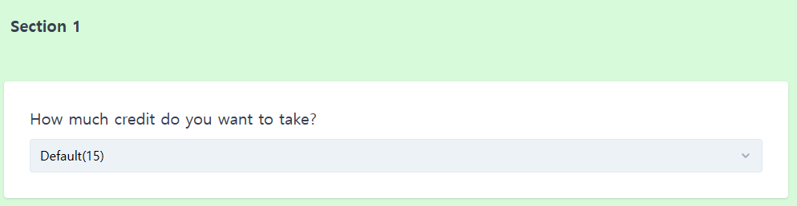
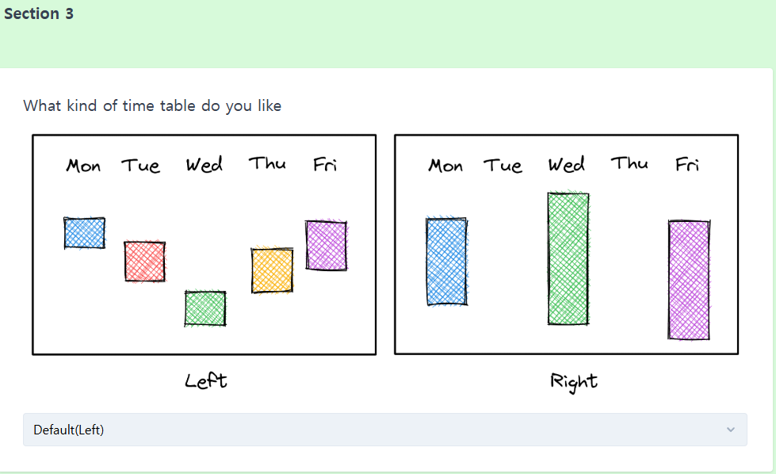
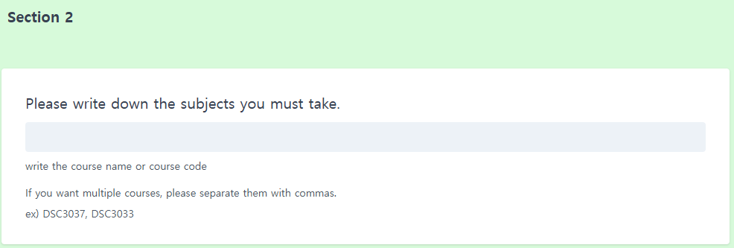
Timetable for skku
Implementation
Survey page
Explore the various elements required to create timetable.
User flow

Slide 18
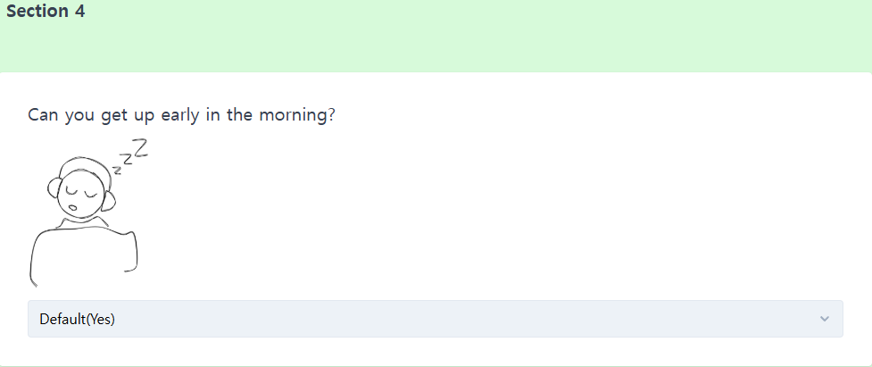
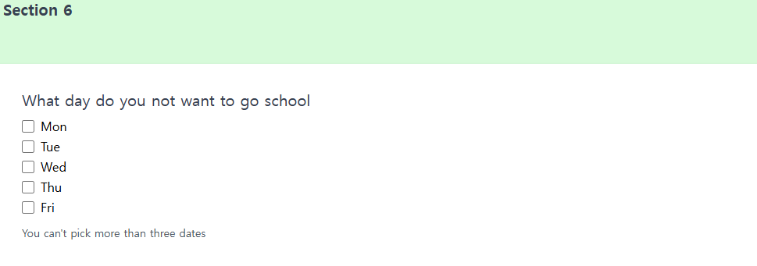
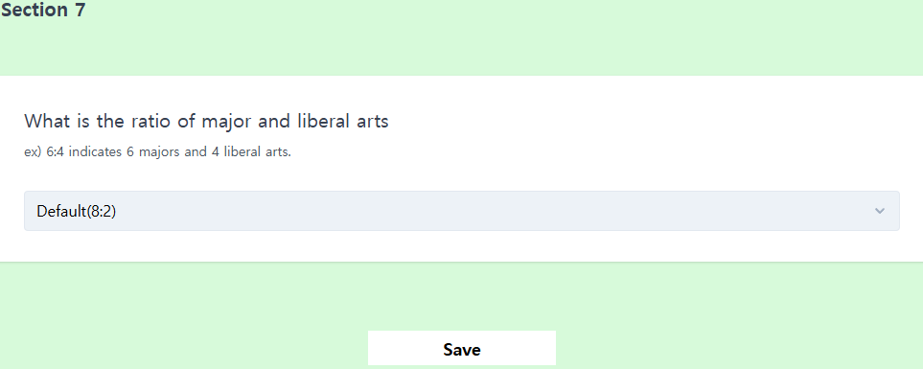
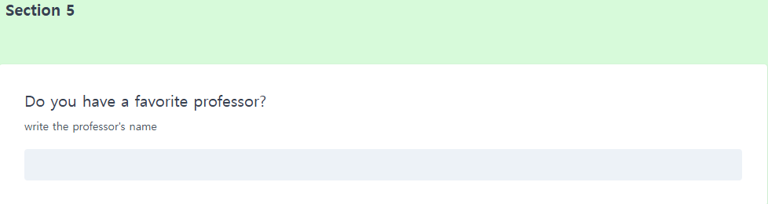
Timetable for skku
Implementation
Survey page
Click the "Save" button to proceed to the Timetable page.
User flow

Slide 19
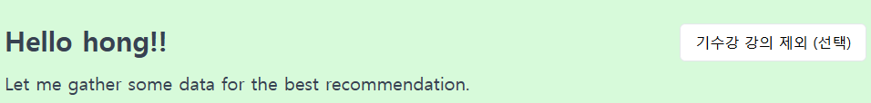
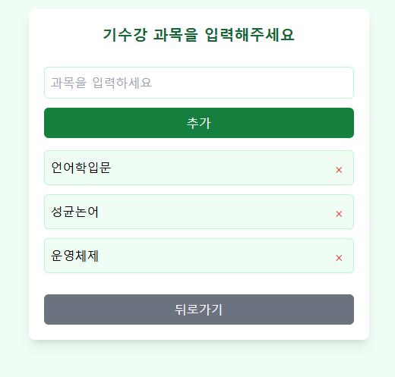
Timetable for skku
Implementation
User flow
History page
Navigate to the History page by clicking the button at the top of the Survey page.
Add a course by entering its name and clicking the "Add" button.
Added courses will not appear in the timetable.
Remove added courses by clicking the red "X" next to them.
Return to the Survey page by pressing the "Back" button.

Slide 20
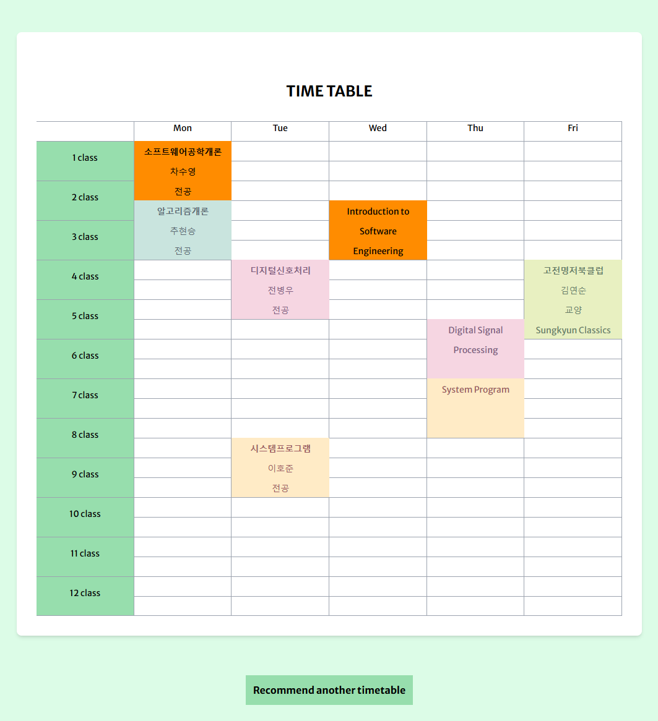
Timetable for skku
Implementation
User flow
Timetable page
View your generated timetable here.
To regenerate it, press the button below or refresh the page (F5).
Click on a lecture to pin it to your timetable. Click again to unpin it.
Pinned lectures will have a different color to indicate they are fixed.

Slide 21
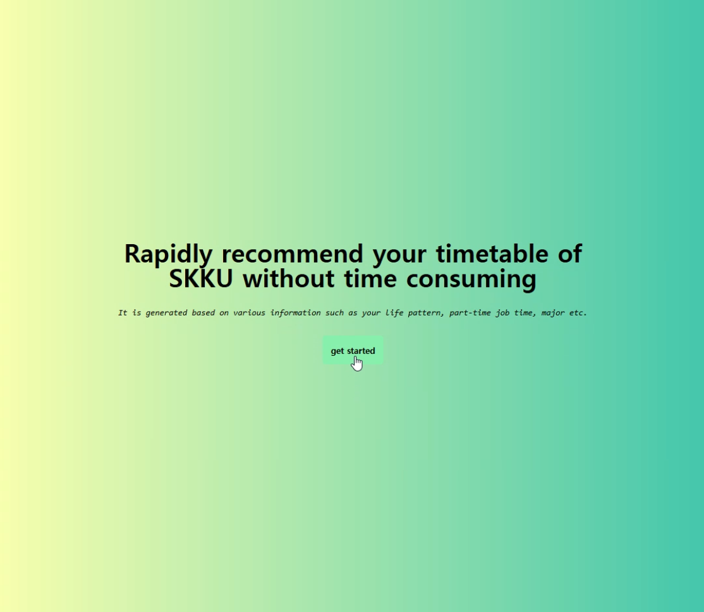
Timetable for skku
Demo Video
You can access at
http://www.skku-timetable.site

Slide 22
Timetable for skku
Section 4
Test plan & result

Slide 23



Timetable for skku
Objectives
Validate the functionality, usability, and reliability of the program.
Ensure that the system meets user requirements and provides an optimized user experience.
Identify and address bugs or inefficiencies before deployment.

Slide 24
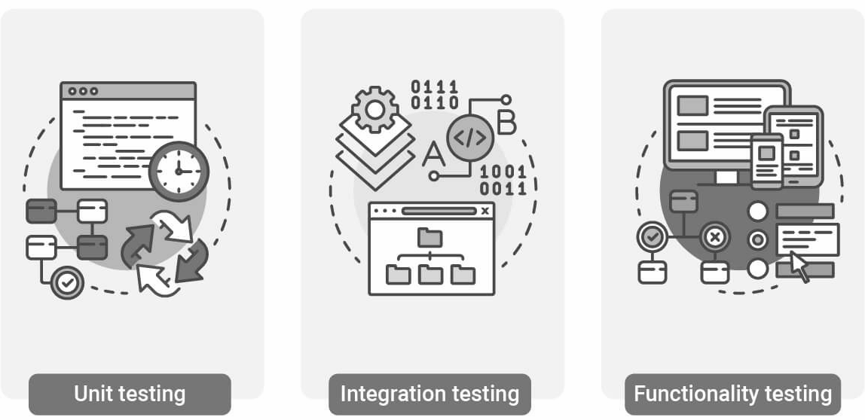
Timetable for skku
Test Plan
Unit Tests:
Verify individual basic required functions
Integration Tests: Ensure seamless interaction between modules.
System Tests: Validate end-to-end functionality under real-world scenarios.

Slide 25
Timetable for skku
Test Result - Unit Test
Test Case | Scenario | Expected Outcome | Actual Outcome | Status
Login with valid input | Enter correct username and password. | Successfully login and redirect to survey page. | Redirected successfully. | Pass
Login with invalid input | Enter incorrect username or password. | Display error message "Invalid login credentials." | Error displayed. | Pass
Register new user | Enter valid registration details. | Account created, redirect to login page. | Account created. | Pass
Generate timetable | Submit survey with valid preferences. | Timetable generated based on preferences. | Timetable generated. | Pass
Pin a course | Click on a course in the timetable. | Course highlighted and locked in place. | Course pinned. | Pass
Exclude unavailable days | Mark Monday as unavailable. | No courses scheduled on Monday. | No Monday courses. | Pass

Slide 26
Timetable for skku
Test Result - Integration Test
Test Case | Scenario | Expected Outcome | Actual Outcome | Status
Survey to timetable workflow | Complete survey and generate timetable. | Timetable generated based on survey input. | Matches preferences. | Pass
History page update | Add a course to exclusions and regenerate timetable. | Excluded course does not appear in timetable. | Excluded successful. | Pass
Login to survey redirection | Login and proceed to the survey page. | User redirected to the correct page. | Redirect successful. | Pass
Timetable regeneration | Modify preferences and regenerate timetable. | Updated timetable matches new preferences. | Regenerated correctly | Pass

Slide 27
Timetable for skku
Test Result - System Test
Test Case | Scenario | Expected Outcome | Actual Outcome | Status
End-to-end workflow | Register -> Login -> Survey -> Generate timetable. | Seamless transition through all steps. | Smooth workflow. | Pass
Multi-user access | Two users generate times tables simultaneously | Both users see their unique schedules. | No data overlap. | Pass
Browser compatibility | Open app in Chrome, Firefox, Safari and Edge | App functions uniformly across browsers. | All browsers supported | Pass

Slide 28
Timetable for skku
Observation & Improvement
Observations
Functionality:
Core features like login, survey, and timetable generation work seamlessly for most test cases.
Minor bugs in timetable pinning feature observed during initial tests.
Performance:
The system supports up to 100 concurrent users with acceptable response times.
Performance degradation noticed with >100 concurrent users.
Usability:
Positive user feedback on the interface and overall flow.
Confusion reported on certain survey questions and history page navigation.

Slide 29
THANK YOU!

